Slide 1





Student Health Insurance Plan for University of North Carolina System
Effective August 1, 2026 - July 31, 2027
This presentation contains audio. Please make sure your speakers are on. The transcript of this presentation is available by clicking the page icon in the right-hand corner of the screen.
Proprietary & Confidential
Notes:
Hello! Welcome to this presentation about the Student Blue Health Insurance Plan for the University of North Carolina System. UNC selected Student Blue to provide you with quality health insurance coverage from Blue Cross and Blue Shield of North Carolina (Blue Cross NC)!
There are important changes to coverage for this academic year, including a shift to one health plan (instead of two). If you had coverage last year, please review this presentation carefully.

Slide 2
You Must Enroll or Waive Coverage
Eligible students are required to have health insurance.
Find your school | Student Blue | Blue Cross NC or visit StudentBlueNC.com
If you don’t already have a Student Blue account, click the “Enroll for Coverage” button or the click “Request Waiver” button.
If you already have a Student Blue account, enter your username (email address) and one-time passcode to access your account and enroll or request a waiver.
If you enroll, you will get an email with an enrollment confirmation number. Your Student Blue member ID card will be mailed to the address you provide.
If you request a waiver, it needs to be approved. If approved, the health insurance charge will then be removed from your student account.
Notes:
The UNC System requires that eligible students must have health insurance. You may be covered under your own insurance plan or your parents’ plan – or you may choose to enroll in Student Blue. You must make an election to enroll or waive coverage. It’s easy!
First, use this link to Find Your School. Or you may visit StudentBlueNC.com.
If you don’t have an account with Student Blue, click the Enroll for Coverage button or the Request Waiver button and provide the required information.
If you already have a Student Blue account, enter your username and a one-time passcode to access your account. From there you can enroll or request a waiver.
If you enroll, you will get an email with a confirmation number. Please keep this for your records. A Student Blue member ID card will also be mailed to the address you provide.
If you request a waiver, it needs to be approved. You will get an email with your approval or denial of this request. If approved, the health insurance charge will then be removed from your student account.

Slide 3
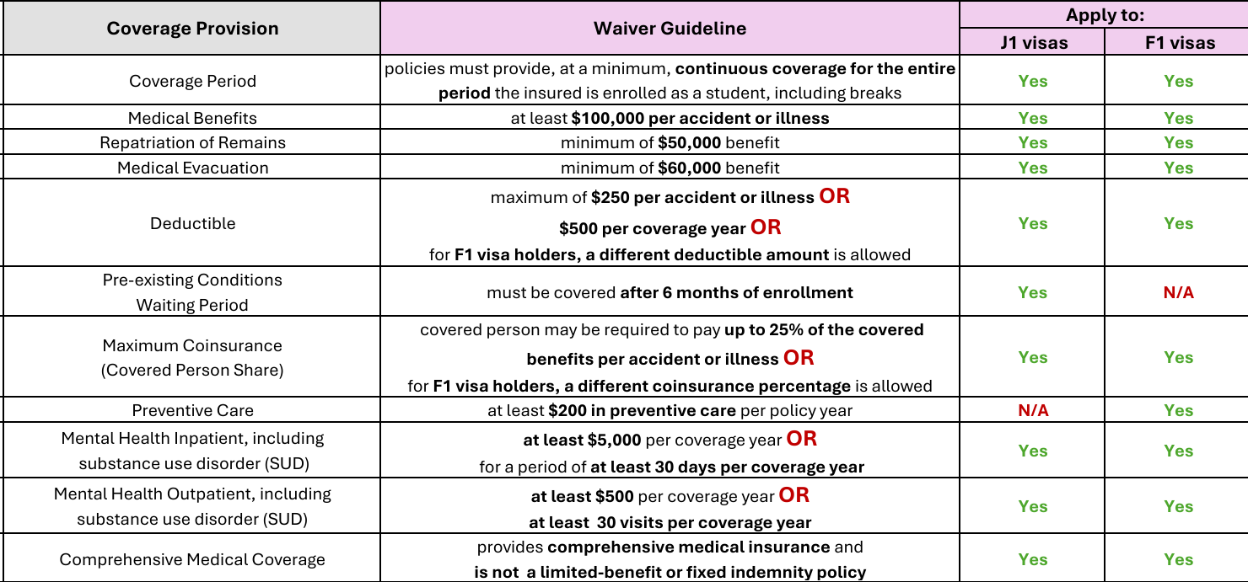
International Students
You may waive Student Blue if you have coverage that meets these guidelines.
Notes:
If you are an international student, you may waive Student Blue health plan coverage if you have other health plan coverage that meets certain requirements. Please press pause if you’d like to review these requirements.

Slide 4
Dates and Rates
You must enroll or waive coverage each semester no later than:
Fall Semester: September 10, 2026
Spring Semester: January 31, 2027
 | Fall Semester (8/1/2026 -12/31/2026) | Spring Semester (1/1/2027 – 7/31/2027)
Undergraduate | $1,312.00 | $1,312.00
Graduate | $2,366.50 | $2,366.50
Notes:
You must enroll or waive coverage no later than September 10, 2026, for the Fall 2026 semester and by January 31, 2027, for the Spring 2027 semester.
Each semester the Student Health Insurance Premium is added to all eligible students’ University accounts. Eligible students must pay the premium and enroll or complete the online waiver request. Your cost depends on whether you are an undergraduate student or graduate student.

Slide 5

Preventive Care
Covered at 100% if provided by an in-network provider and billed as preventive care.
Adult screening tests
Immunizations
Mammograms
Colon cancer screenings
$0
at Student Health Services
Visit BlueCrossNC.com/preventive
Preventive care services, as defined by federal regulations, are covered at no charge in-network. Federally-and state-mandated preventive services are available out-of-network, for which members will pay deductible and coinsurance, plus charges over the allowed amount. Visit BlueCrossNC.com/Preventive for more details.
Notes:
Now let’s take a look at your Student Blue benefits, starting with preventive care. Preventive care is routine health care that can help prevent illnesses, diseases or other health problems, such as flu shots, cancer screenings and blood pressure checks.
With your Student Blue health plan, there is no charge for preventive care if you visit UNC’s Student Health Services or another in-network doctor.
To learn more about preventive care, check out your benefit booklet or visit BlueCrossNC.com/preventive.
With your Student Blue health plan, there is no charge for preventive care if you visit UNC’s Student Health Services or another in-network doctor.

Slide 6
Copays
Benefit | In-Network | Out-of-Network¹
Student Health Center | $0 copay | n/a
Primary Care Provider (PCP) Office Visit
$90 copay
You pay 60%
Mental Health Office Visit
$10 copay
You pay 60%
Specialist Office Visit
$150 copay
You pay 60%
Urgent Care Visit
$175 copay
$350 copay
Emergency Room Visit
$750 copay for 1st visit; $1,250 for additional visits
1. If you visit out-of-network providers, you may be responsible for paying any charges over the allowed amount in addition to any applicable co-pay, deductible, coinsurance, non-covered expenses and certification penalty amounts, if any, except for emergency services in the case of an emergency. Failure to request prior review and obtain certification for inpatient services may result in a full denial of benefits. See your member guide for details. 2. Emergency Room Visit (with or without observation) has a copay. If you are admitted, you’ll pay coinsurance after you meet your deductible.
Notes:
With your Student Blue health plan, you’ll pay copays for certain health care services. A copay is a fixed dollar amount you pay at the time the service is received.
Keep in mind, there is no charge for visits to the Student Health Center.
If your Primary Care Provider is in-network, you will pay a $90 copay for an office visit. If you see the PCP that you select in your Blue Cross NC Member Portal, however, the first three copays to that provider are waived. See your benefit booklet for details. If you have an in-network mental health office visit, you’ll pay a $10 copay. If you see an in-network specialist, you’ll pay a $150 copay and if you go to an in-network urgent care center, you’ll pay a $175 copay. If you go to the emergency room, you’ll pay a $750 copay for the first visit, and any additional visits (during the plan year) will have a $1,250 copay.
With your health plan, you have the option of visiting doctors outside of the network, but in most cases, you’ll pay more for those services.

Slide 7

Deductible
Your deductible applies to:
Inpatient hospital services
Outpatient hospital services
Diagnostic imaging
Maternity care
Home health care
Hospice
Skilled nursing
Durable medical equipment
More
Deductibles, coinsurance/copayments, limitations and exclusions may apply to this coverage. Further details of coverage, limitations and exclusions, and terms under which the policy can be continued in force will be provided in your Benefit Booklet.
Notes:
Some health care services, like these you see here, do not have a copay. But they do count toward your deductible – which is the amount you pay for care before your plan begins to pay for covered services. Your deductible accumulates (or adds up) throughout the benefit period and re-sets to zero when your health care plan renews each year.
For a list of all covered services, please refer to your benefit booklet.

Slide 8
Deductible and Coinsurance
 | In-Network | Out-of-Network¹
First, you’ll meet your deductible
Individual | $2,000 | $4,000
Then you’ll pay…
Coinsurance | 40% | 60%
Until you reach your total out-of-pocket limit²
Individual | $9,600 | $19,200
Then the plan pays 100%³ for the rest of the plan year.
1. If you visit out-of-network providers, you may be responsible for paying any charges over the allowed amount in addition to any applicable copay, deductible, coinsurance, non-covered expenses and certification penalty amounts, if any, except for emergency services in the case of an emergency. Failure to request prior review and obtain certification for inpatient services may result in a full denial of benefits. 2. Your total out-of-pocket limit includes your deductible, coinsurance and copays, if applicable. 3. Once you reach your total out-of-pocket limit, your plan pays 100% of covered services for the rest of the plan year.
Notes:
For the 2026-2027 plan year, you have an in-network deductible of $2,000.
Once you reach your deductible amount, your plan will pay 60% of your in-network health care costs, and you’ll pay the other 40% (plus any copays you may have) until you reach your total out-of-pocket limit. This percentage of your health care costs is called coinsurance.
We add together what you pay in copays, deductible, and coinsurance, and that counts towards your total out-of-pocket limit. When you reach this amount, your plan pays all of your covered in-network medical services for the rest of your health care plan year.
If you see out-of-network providers, you will have a higher deductible, coinsurance and out-of-pocket limit.

Slide 9
Prescription Drug Benefits
Notes:
Now I’ll show you how prescriptions will be covered and how to save money when you fill them at the pharmacy.

Slide 10
Prescription Coverage
 | In-Network¹ | Out-of-Network²
Preventive Medicines³ | No charge, no deductible | No charge, no deductible
Student Health Center | $15 copay
Tier 1 | $30 copay
Tier 2 | $40 copay
Tier 3 | $70 copay
Tier 4
Tier 5
You pay
the in-network cost plus the difference
between the charged and allowed amounts.
You pay 25%
($150 - $500)⁴
For a 30-day supply.
You are responsible for charges over the allowed amount for prescriptions received from an out-of-network pharmacy.
For a list of covered preventive care medicines, refer to your benefit booklet or click here.
There is a $150 minimum and $500 maximum per 30-day supply of a tier 4 and 5 medicine.
3 There is a $XX minimum and $XXX maximum per 30-day supply of a tier 5 medicine.
You are responsible for charges over the allowed amount for prescriptions received from an out-of-network pharmacy.
Notes:
If your prescribed medicine is on the ACA preventive drug list, that medicine is covered at 100%. You may click “Preventive Medicines” to see a list and learn more.
If you get your prescribed medicine filled at the Student Health Center, you’ll pay just a $15 copay for each 30-day supply.
You’ll pay higher copays for prescriptions filled at in-network pharmacies depending on the tier of medicine. The lowest cost medicines are in tier one, and you will pay a $30 copay for each 30-day supply. You’ll pay higher copays for medicines in tiers 2 and 3. The highest cost medicines are in tiers 4 and 5, and for these, you’ll pay 25% of the discounted cost of the medicine. There is a $150 minimum, but you’ll pay no more than $500 maximum, for each 30-day supply.

Slide 11

Covered Medicines
Your health plan includes a list of covered drugs (called a formulary) which shows you:
Which medicines are covered
What tier your medicine is in
Whether your medicine requires approval
How much medicine you can get
Click here to learn how to find your plan's formulary.
Notes:
Your health plan uses a drug list (or formulary) as a guide for covering medicines. The drug list shows you all the medicines and related products that are covered by your health plan, and what tier they’re in. It also tells you if a medicine requires approval before it can be filled, or if there are limits on how much medicine can be filled.
Click here to learn how to find your plan’s formulary on BlueCrossNC.com.

Slide 12

Ways To Save On Your Medicines
Here are some tips to keep costs lower when filling your prescriptions:
Get your prescriptions at an in-network pharmacy
Ask your doctor:
  if there is a less expensive option (lower tier)
  if there is a generic version
  if you should get a 90-day supply
Notes:
If you’re looking for ways to save money on prescriptions, here are some tips.
First, you want to fill your prescriptions at an in-network pharmacy – they will file your claim for you and charge you only what’s been agreed upon as the allowed amount for your medicine.
Also, talk to your doctor. Ask if there’s option on a lower tier on your plan’s formulary. Sometimes they can prescribe an alternative that costs less. That could include a generic option. Many brand-name drugs have a generic version which means both drugs have the same active ingredient, strength and dosage – but may cost less. And if you’re taking a medicine regularly, ask if you should get a 90-day supply, which can sometimes cost less than a 30-day supply each month.

Slide 13
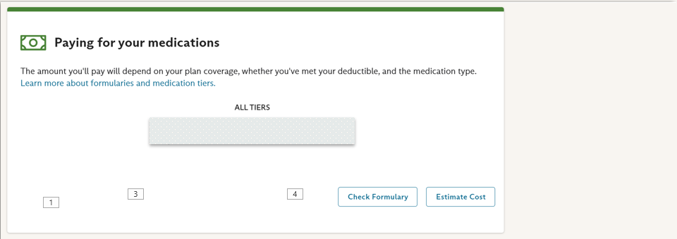
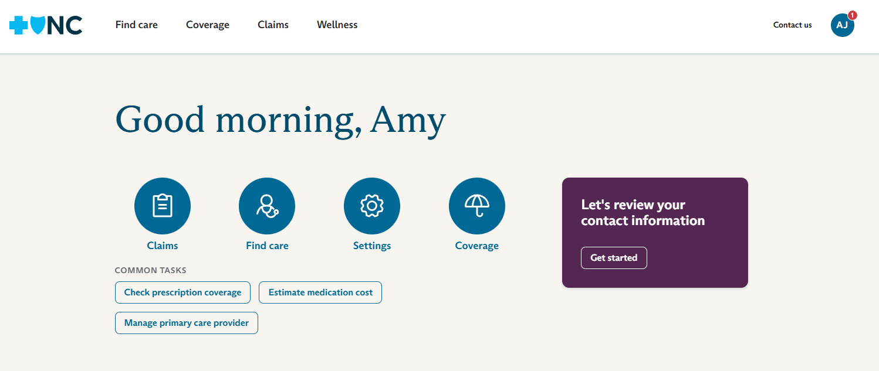
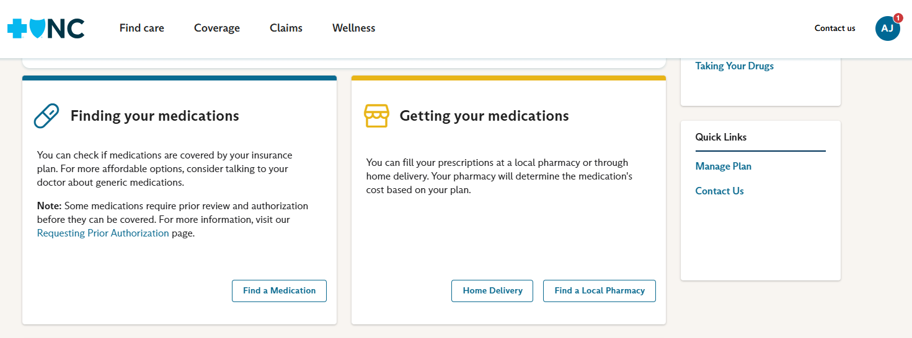
Prescription Coverage
This is a sample page. Your information will vary based on your plan benefits.
Notes:
To learn more about your health plan’s coverage of your medicines, click “Check prescription coverage”.
Click “Find A Medication” to see how your current medicines are covered, or to learn how a prescribed medicine will be covered. You can also click here to learn about home delivery or find a local, in-network pharmacy.
You may also scroll down the page to see how your plan covers prescriptions. Click here to review your formulary or get an estimate of how much your medications will cost.

Slide 14
Amazon Pharmacy
Easy. Fast. Straightforward.
Order your non-specialty medicines and have them delivered to your home
Free, fast delivery and real-time package tracking
Option for 90+ day fills
Pharmacist on call 24/7
Manage your medicine and order history online
Get our lowest cost available with MedsYourWay® discount card pricing
Learn more at amazon.com/bluecrossNC and click “Get started”
If your plan has a mandatory mail program, you must use that program for your mail order prescriptions, and you would not be eligible to use Amazon Pharmacy.
If your medicine has an unfulfilled requirement at the time you place your order, the cost may not count toward your out-of-pocket maximum (accumulator). Typical requirements include prior authorization (PA), quantity limits exceeded or step therapy.
Amazon Pharmacy does not dispense controlled substances (Schedule 2 medications).
MedsYourWay is a prescription drug discount card, administered by Inside Rx® LLC. MedsYourWay discount card pricing is built into the Amazon Pharmacy shopping experience. You are responsible for the cost of your prescription(s) when using the MedsYourWay card. Limitations apply. Inside Rx LLC and Amazon Pharmacy are independent companies that are solely responsible for the services they provide on behalf of Blue Cross NC and do not offer Blue Cross or Blue Shield products or services.
Notes:
Blue Cross NC also offers Amazon Pharmacy – an easy, fast and straightforward way to save money on medicine.
With Amazon Pharmacy you can order your non-specialty medicines and have them delivered to your home by Amazon. You’ll receive free, fast delivery and can track your package in real-time. You have the option to get 90+ day fills and you may contact a pharmacist 24/7. You can also manage your medicine and order history online. And all this while getting our lowest cost available for your prescriptions with MedsYourWay discount card pricing.
Sign up and learn more by visiting amazon.com/BlueCrossNC and click on the “Get started” link.

Slide 15

Blue Cross NC Member Portal
Search for doctors, hospitals and pharmacies
Select an in-network Primary Care Provider (PCP) for easy access to care
See deductible, claims and benefits
Access important documents like your member ID card and Explanation of Benefits (EOB)
Compare estimated costs for providers, prescriptions and procedures
Click here to learn how to access the portal.
Blue Cross and Blue Shield of North Carolina (Blue Cross NC) offers several decision support tools to aid our members in making decisions around their health care experience. These tools are offered for convenience and should be used only as reference tools. Members should consult their own legal counsel, tax advisor or personal physician as applicable throughout their health care experience.
Notes:
When you become a member of Student Blue, register for your Blue Cross NC Member Portal. This is more than a member services website -- it’s a guide to the tools you need to manage your health plan and your health care.
Here you can:
Search for doctors, hospitals and pharmacies using our Find Care tools
Select an in-network PCP for easy access to care
See deductible, claims and benefits
Access important documents like digital member ID cards and EOBs
And compare estimated costs for providers, prescriptions and procedures
Click here to learn more about the portal and how to register.

Slide 16

Know Where To Get Care
Notes:
In addition to seeing an in-network provider, you want to consider where to get care.
When you or a loved one gets sick or injured, it can be scary! You may not be sure where you should go – especially at night or on the weekend. Can it wait until your doctor's office opens? Should you head to urgent care? Is it serious enough for the emergency room? It’s not always easy to make the best decision, but it is important! Your time, cost, and amount of hassle can be very different based on where you go for care.

Slide 17

Emergency
A medical condition severe enough to make a reasonable person believe their health or life is in serious jeopardy.
In an emergency, always call 911 or go to the nearest emergency room.
An emergency is the sudden and unexpected onset of a condition of such severity that a prudent layperson, who possesses an average knowledge of health and medicine, could reasonably expect the absence of immediate medical attention to result in any of the following: Placing the health of an individual, or with respect to a pregnant woman the health of the pregnant woman or her unborn child, in serious jeopardy, serious physical impairment to bodily functions, serious dysfunction of any bodily organ or part, or death. If you have any questions concerning your medical condition or any drugs, treatment plans or new symptoms, consult your health care provider.
Notes:
The first thing to do is decide if the care you need is an emergency. An emergency is a medical condition severe enough to make a reasonable person believe their health or life is in serious jeopardy. If you have an issue that threatens your life or health, never wait. Call 911 or go straight to the nearest emergency room!

Slide 18






You Have Choices
Student Health Services
$0
$
Primary Care
$
Retail/Convenience Care
$
Telehealth Services
Urgent Care
$$
$$$$
Emergency Room
Notes:
But when it’s not quite an emergency – what should you do?
Remember if you visit Student Health Services, those visits cost you $0.
Or you may want to visit your primary care provider. Many doctors now offer walk-in, same day appointments. Others now offer weekend or evening hours.
Some retail pharmacies offer in-store convenience care for treatment of minor health issues.
Your health plan also includes telehealth services where you can speak to a doctor through your computer or an app on your phone.
And for some illnesses and injuries, an urgent care center can be a real time and money saver!
Generally, the emergency room is the most expensive place to get care for an illness or injury that isn’t an emergency, and you may have to wait a long time to be seen. Nobody wants to spend more money or time on health care than they have to. But that’s exactly what happens when it comes to many emergency room visits, because they can involve issues that simply aren’t emergencies.

Slide 19

Telehealth Benefits
Teladoc® Health, Inc. interactive consultations are available 24 hours a day, 7 days a week. Telehealth services are subject to the terms and conditions of the member's health plan, including benefits, limitations and exclusions. Teladoc Health does not replace your primary care doctor. Telehealth services are not a substitute for emergency care. Teladoc Health is subject to state regulations. Behavioral health telehealth is currently only available to members ages 13 or older. Teladoc Health is an independent company that is solely responsible for the telehealth services it is providing; please see Teladoc Health website for more information. Teladoc Health does not offer Blue Cross or Blue Shield products or services.
Notes:
Now I’ll introduce your telehealth benefits with Teladoc Health as part of your Student Blue health plan.

Slide 20

How It Works
Meet with a board-certified doctor by phone or video who can diagnose symptoms and prescribe medicine for a range of health care needs:
  Primary care
  24/7 non-urgent acute care
  Mental health care
  Dermatology
  Nutritional counseling
You will pay $0 for Teladoc Health visits.
Teladoc Health, Inc. does not prescribe DEA-controlled substances and may not prescribe nontherapeutic drugs and certain other drugs which may be harmful because of their potential for abuse. Teladoc Health does not guarantee patients will receive a prescription.
Notes:
Teladoc Health provides virtual access (by phone or video) with board-certified doctors who can diagnose symptoms and prescribe medicine for a range of health care needs including primary care, 24/7 non-urgent acute care, mental health care, dermatology and nutritional counseling.
You can save time and money with Teladoc Health. You’ll pay $0 for each Teladoc Health visit with your Student Blue health plan.

Slide 21

Get Started
Download the Teladoc Health mobile app
(iOS-/AndroidTM - supported)
Go to TeladocHealth.com and click “Sign in” or “Register Now”
Call 1-855-549-2214
Please note: you must wait until your health plan effective date before registering for telehealth services.
Notes:
There are three ways to get started with Teladoc Health. Just download their mobile app, visit TeladocHealth.com or call 1-855-549-2214. Have your Blue Cross NC member ID card handy to register. Go ahead and activate your account, so when you need Teladoc Health, you’ll be ready.

Slide 22
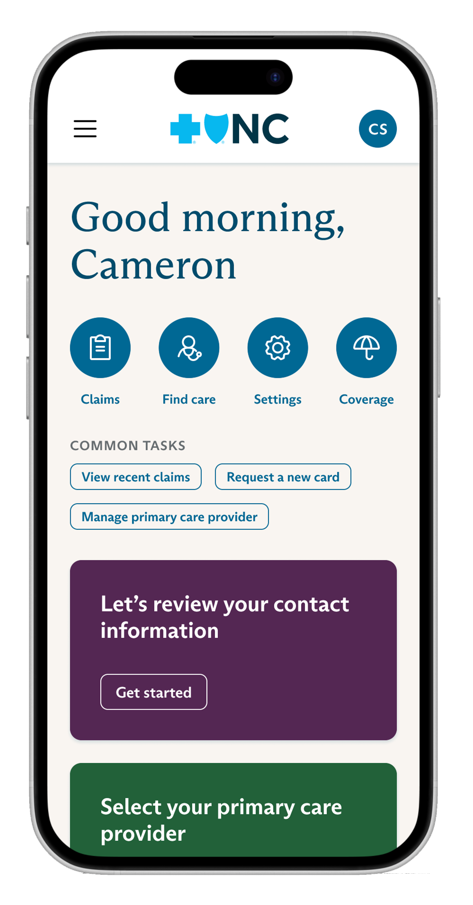


Blue Cross NC Mobile App
Get your health plan information in the palm of your hand.
Download your digital ID Card
View your claims
See a summary of your benefits
Track your deductibles, expenses
Call/message customer service
Use fingerprint/Touch IDTM sign-in
Apple Wallet and iPhone® are registered trademarks and App Store is a service mark of Apple Inc., registered in the U.S. and other countries. Google Wallet, Google Play and AndroidTM are trademarks of Google LLC.
Notes:
And as you get the care you need, you can have your health plan information right in the palm of your hand! Blue Cross NC Mobile lets you securely connect to your Blue Cross NC health plan whenever you want.
Download your digital member ID card to your Apple or Google wallet. View your claims. Or track your benefits, deductibles, and out of pocket expenses. You can call customer service or send a message through the app. Fingerprint/Touch ID sign in is available on certain devices.
The mobile app is available on the App Store and Google Play.

Slide 23
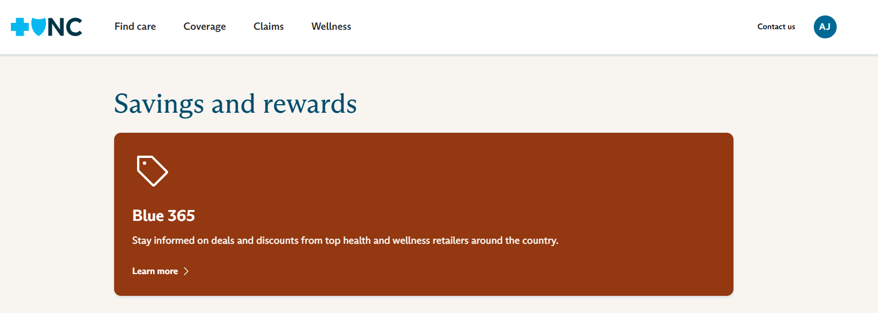
Blue365® Discounts
Get great deals delivered to your in-box.
Gym memberships & fitness gear
Vision & hearing care
Weight loss & nutrition programs
Travel & family activities
Mind/body wellness
Blue365 offers access to savings on items that members may purchase directly from independent vendors, which are different from items that are covered under the policies with Blue Cross NC. Blue Cross and Blue Shield Association (BCBSA) may receive payments from Blue365 vendors. Neither Blue Cross NC nor BCBSA recommends, endorses, warrants or guarantees any specific Blue365 vendor or item. This program may be modified or discontinued at any time without prior notice.
Notes:
Don’t forget to check out your member discounts available through Blue365® on your Blue Cross NC member portal. Looks for “savings and rewards” on the home page.
This program can help you save money every day of the year, while you stay healthy. Blue365® offers discounts on healthy products and services – everything from gym memberships to nutrition programs to laser eye surgery! When you sign up, you’ll get special weekly deals from well-known companies – delivered right to your email inbox.

Slide 24
Questions?
Go to StudentBlueNC.com
Download Blue Cross NC Mobile
Call the number on the back of your member ID card
Visit your Student Health Center
Blue Cross NC offers several decision support tools to aid you in making decisions around your health care experience. These tools are offered for your convenience and should be used only as reference tools. You should consult your own legal counsel, tax advisor or personal physician as applicable throughout your health care experience.
®, SM are marks of the Blue Cross and Blue Shield Association, an association of independent Blue Cross and Blue Shield plans. All other marks and names are property of their respective owners. Blue Cross and Blue Shield of North Carolina is an independent licensee of the Blue Cross and Blue Shield Association.
BOptions, 5/25. U48807, 6/26
Notes:
Thank you for watching this presentation. We’re here to help you get the most out of your Student Blue health insurance plan.
Get connected – log into StudentBlueNC.com and download Blue Cross NC Mobile today.
If you have any questions, call us at the number on the back of Blue Cross NC member ID card.
And remember to take advantage of the valuable services through your Student Health Center.

